Slide 1
jUnit: a Java unit testing framework

Slide 2
jUnit
A simple Unit testing framework
  http://junit.sourceforge.net
Familiarize yourself with the JUnit API.
  It is not very big.
  http://kentbeck.github.com/junit/javadoc/latest/
There was a major refactoring done in JUnit 4.x vs. 3.x. We will focus on version 4.

Slide 3
jUnit features
Separate test class instances and class loaders for each unit test to avoid side effects
jUnit annotations to provide resource initialization and reclamation methods: @Before, @BeforeClass, @After and @AfterClass
Many assert methods to check results
Integration with Eclipse, NetBeans

Slide 4
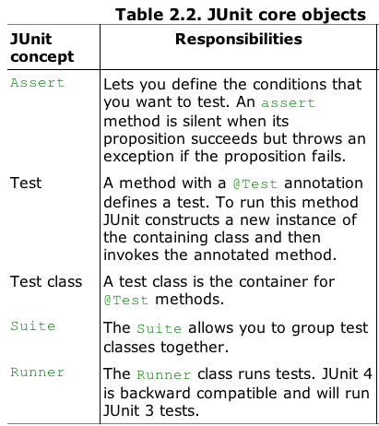
jUnit core objects

Slide 5
Main Goals of Unit Testing Frameworks
Each unit test should run independently of all other unit tests.
The framework should detect and report errors test by test.
It should be easy to define which unit tests will run.

Slide 6
Why use JUnit?
See the Calculator example without JUnit Tests.
This is how you would test if your calculator with one method add, works, if you didn’t know how to write unit tests.
  Calculator1.java
  Calculator2.java

Slide 7
Three Main Goals of Unit Testing Frameworks
Each unit test should run independently of all other unit tests.
The framework should detect and report errors test by test.
It should be easy to define which unit tests will run.

Slide 8
Setting up JUnit
jUnit is part of the Eclipse distribution
Alternatively, download the JUnit distribution directly
Unzip the jar file.
JUnit comes with Java programs you can use to view the result of a test.
java -cp junit-4.8.2.jar;. junit.samples.AllTests
JUnit text test runner displays passing tests with a dot. Errors are shown with an E instead of a dot.

Slide 9
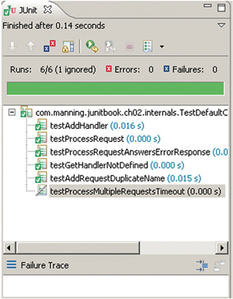
JUnit Features
Separate test class instances and class loaders for each unit test to avoid side effects
Junit annotations to provide resource initialization and reclamation methods: @Before, @BeforeClass, @After and @AfterClass
Many assert methods to check results
Integration with Eclipse, NetBeans

Slide 10
Writing and Running a Test
See CalculatorTest.java for the JUnit test.
To compile
javac –cp .;junit-4.8.2.jar *.java
To run
java -cp .;junit-4.8.2.jar
org.junit.runner.JUnitCore CalculatorTest

Slide 11
Writing a TestCase JUnit 3 -OLD
import junit.framework.TestCase;
public class TestMovieList extends TestCase {
public void testEmptyList(){
//setup preconditions
MovieList emptyList = new MovieList();
// exercise functionality
//check post conditions
assertEquals(“Size of empty list should be 0”,
0, emptyList.size())
assertTrue(“An empty list should report empty”,
emptyList.isempty());
}
}

Slide 12
Tests are easier to write
Isn’t a JUnit test easier to write than a list of if statements and try catch clauses?
Compare CalculatorTest.java with CalculatorTest1.java and CalculatorTest2.java

Slide 13
The requirements to define a test class are that the class must be public and contain a zero-argument constructor.
The requirements to create a test method are that it must be annotated with @Test, be public, take no arguments, and return void.

Slide 14
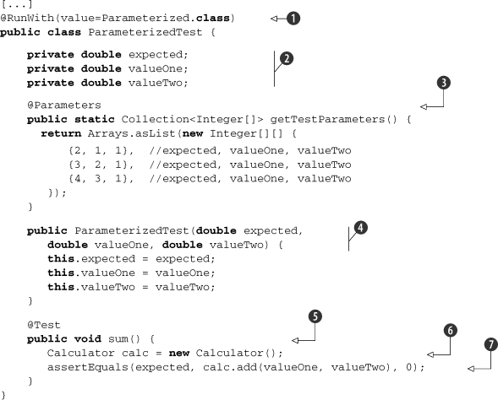
Parameterized tests
The Parameterized test runner allows you to run a test many times with different sets of parameters.
See ParameterizedTest.java

Slide 15
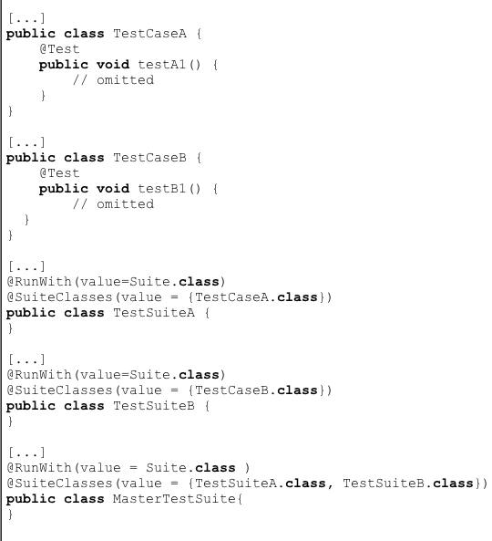
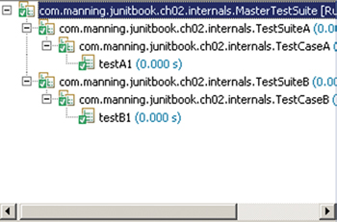
Other classes
Suite class
  Group test classes together
Runner class
  Runs tests

Slide 16
Jhotdraw’s Tests
The tests subpackage in Jhotdraw has some tests written.
Most of them are stubs though.

Slide 17

jUnit Books
O’Reilly books are free to read for Ohio University students.
Notes:
http://proquest.safaribooksonline.com/book/software-engineering-and-development/software-testing/9781449377212/junit-pocket-guide/automating_tests#X2ludGVybmFsX0ZsYXNoUmVhZGVyP3htbGlkPTk3ODE0NDkzNzcyMTIvMTk=

Slide 18
Junit Cookbook
http://junit.sourceforge.net/doc/cookbook/cookbook.htm
Tutorial: http://agile.csc.ncsu.edu/SEMaterials/tutorials/junit/junit_tutorial_jazz.html

